Slide 1
Nonequilibrium phase diagram of an atom-cavity system with three-level atoms
Paul Haffner

Slide 2
Contents
Theoretical backgrounds:
Quantum systems – Time crystals – Dark states
Framework and quations of motion
Phase diagram
Outlook

Slide 3
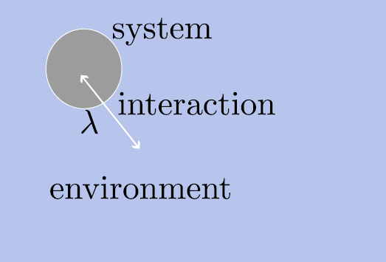
Theoretical background: Quantum systems
Open quantum systems interact with their environment
Their evolution is not purely unitary
There can be influenced by e.g. driving fields or dissipation

Slide 4
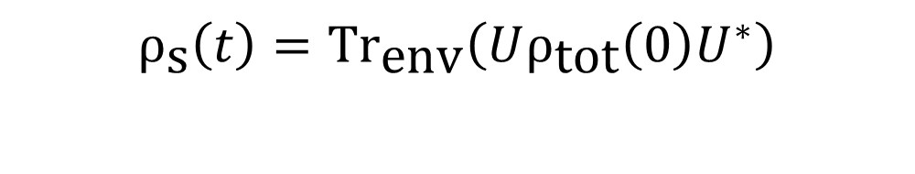

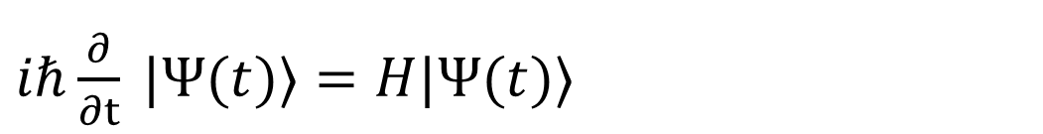
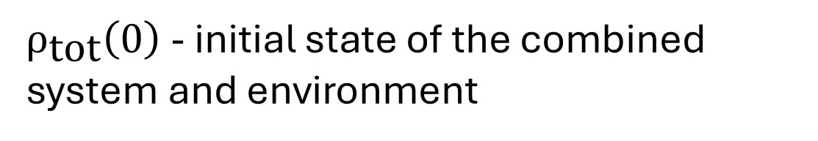
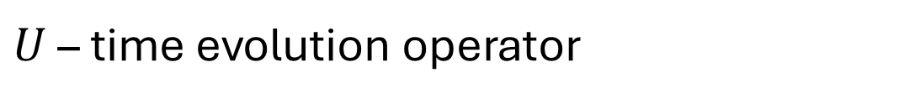
quantum systems with state the pure state $\left|Ψ\right\rangle .$
With $H=H_{\text{sys}}+H_{\text{env}}+λH_{\text{int}}.$
$iℏ\frac{∂}{∂t} |Ψ(t)⟩=H|Ψ(t)⟩$
$H_{\text{sys}}$ - represents the „isolated“ system only
$H_{\text{env}}$ - is the Hamiltonian of the environment alone
$H_{\text{int}}$ - interaction between bath and system
$λ$ - adimensional constant representing interaction strength
Reduced system state is
$U$ – time evolution operator
$$ρ_{\text{s}}\left(t\right)=\text{T}{\text{r}}_{\text{env}}\left(Uρ_{\text{tot}}\left(0\right)U^{∗}\right)$$
$ρ_{\text{tot}}\left(0\right)$ - initial state of the combined system and environment
Challenging or impossible to solve in most cases !

Slide 5
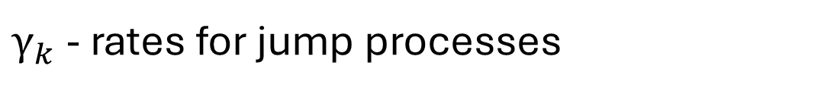

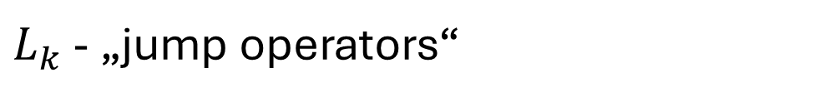
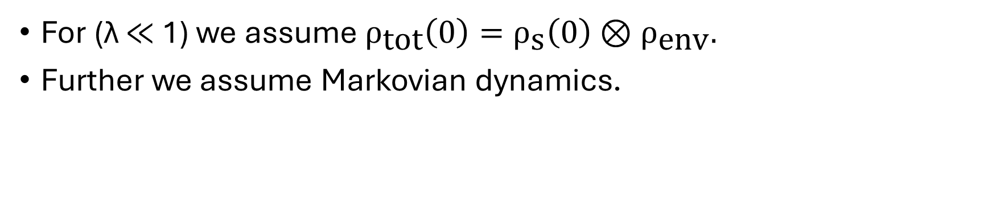

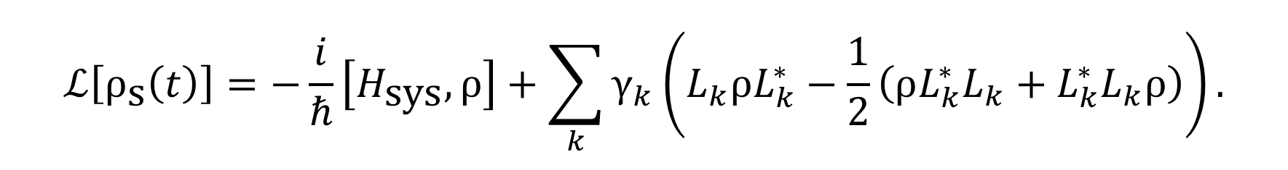
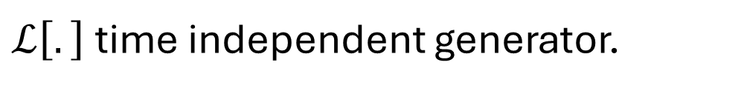
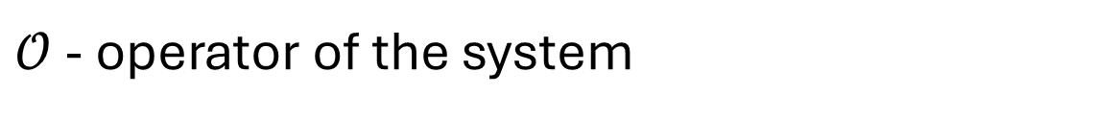
For (λ ≪ 1) we assume $ρ_{\text{tot}}\left(0\right)=ρ_{\text{s}}\left(0\right)⊗ρ_{\text{env}}.$
Further we assume Markovian dynamics.
This simplifies the analysis significantly!
$$\frac{d}{dt}ρ\left(t\right)=ℒ\left[ρ_{\text{s}}\left(t\right)\right].$$
$ℒ\left[.\right]$time independent generator.
Its action on the density operator is given by
The adjoint action is given by
$$ℒ\left[ρ_{\text{s}}\left(t\right)\right]=−\frac{i}{ℏ}\left[H_{\text{sys}},ρ\right]+\sum_{k}{γ_{k}\left(L_{k}ρL_{k}^{∗}−\frac{1}{2}\left(ρL_{k}^{∗}L_{k}+L_{k}^{∗}L_{k}ρ\right)\right)}.$$
$$ℒ^{∗}\left[𝒪\right]=\dot{𝒪}=\frac{i}{ℏ}\left[H,𝒪\right]+\sum_{n}{γ_{n}\left(L_{n}^{∗}𝒪L_{n}−\frac{1}{2}\{L_{n}^{∗}L_{n},𝒪\}\right)}.$$
$L_{k}$ - „jump operators“
$γ_{k}$ - rates for jump processes
$𝒪$ - operator of the system

Slide 6
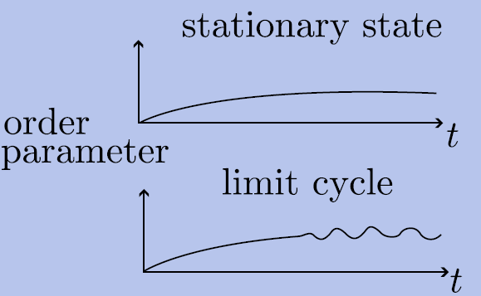
Theoretical background: Time crystals
Many systems relax into stationary states.
Instead of relaxing to a stationary state, some systems exhibit periodic oscillations
They break temporal translation symmetry.

Slide 7

In the context of Markovian open quantum systems, time crystals can be understood as follows.
The formal evolution of the state can be written as $ρ\left(t\right)=e^{ℒt}\left[ρ\left(0\right)\right].$
This evolution exhibits continuous time translation symmetry.
If $ρ_{\text{LC}}\left(t+T\right)=ρ_{\text{LC}}\left(t\right),$ a time crystal emerges. Therby spontaneously breaking the continous time translation symmetry. This can be seen as $e^{ℒT}\left[ρ_{\text{LC}}\left(t\right)\right]≠ρ_{\text{LC}}\left(t+T\right).$
$e^{ℒt}$ - time translation operator

Slide 8
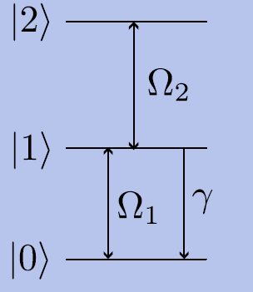

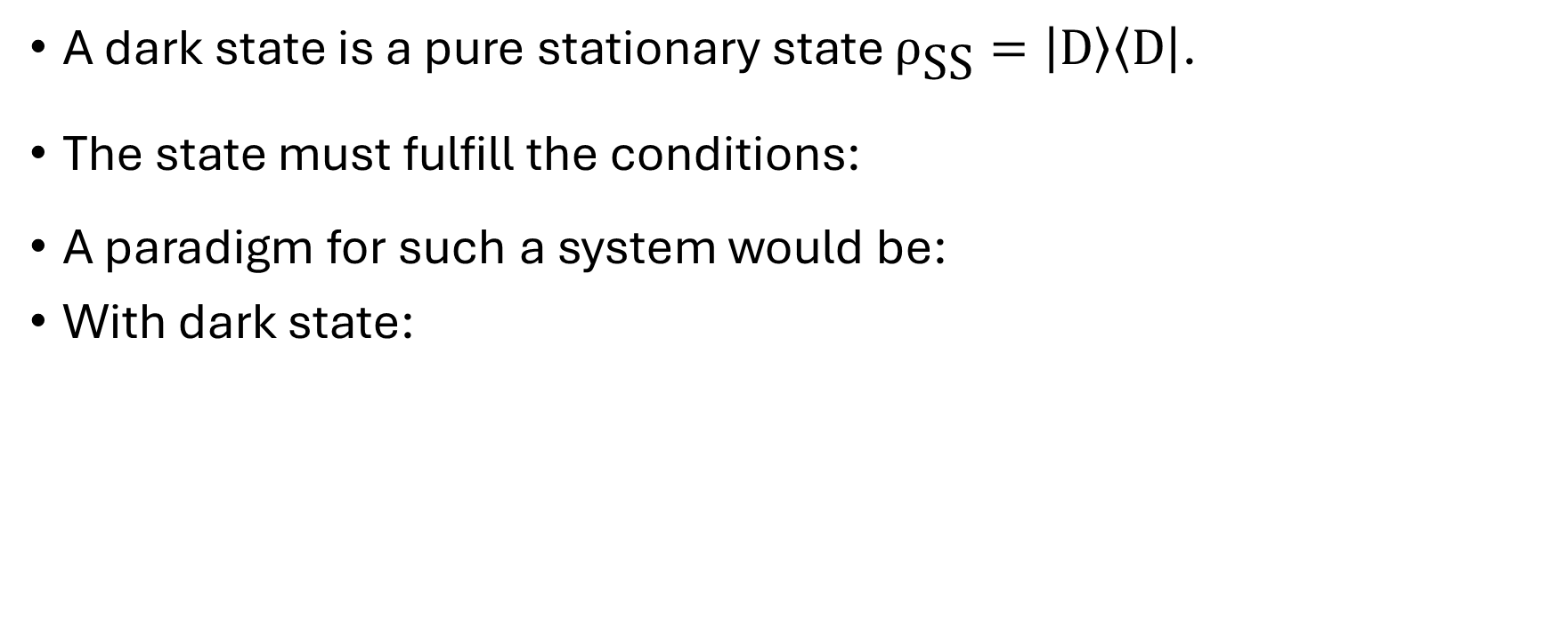
Theoretical backgrounds: Dark states
A dark state is a pure stationary state $ρ_{\text{SS}}=\left|\text{D}\right\rangle \left\langle \text{D}\right|$.
The state must fulfill the conditions:
A paradigm for such a system would be:
With dark state:
$$\left|\text{D}\right\rangle =\frac{1}{\sqrt{Ω_{1}^{2}+Ω_{2}^{2}}} (Ω_{2}\left|0\right\rangle −Ω_{1}|2⟩)$$

Slide 9
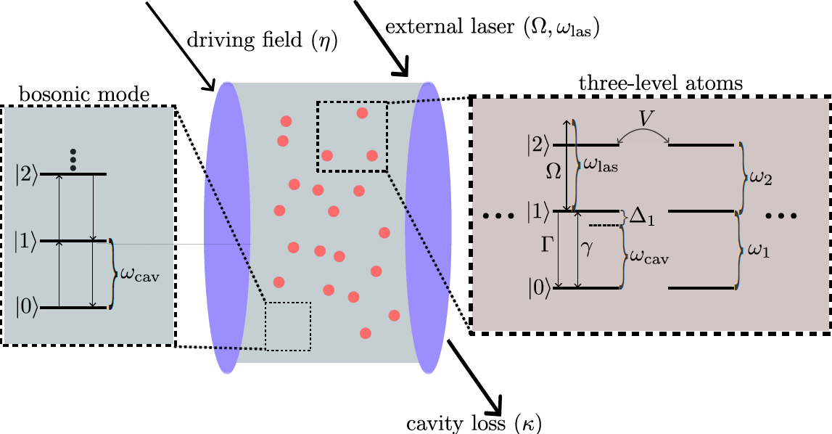
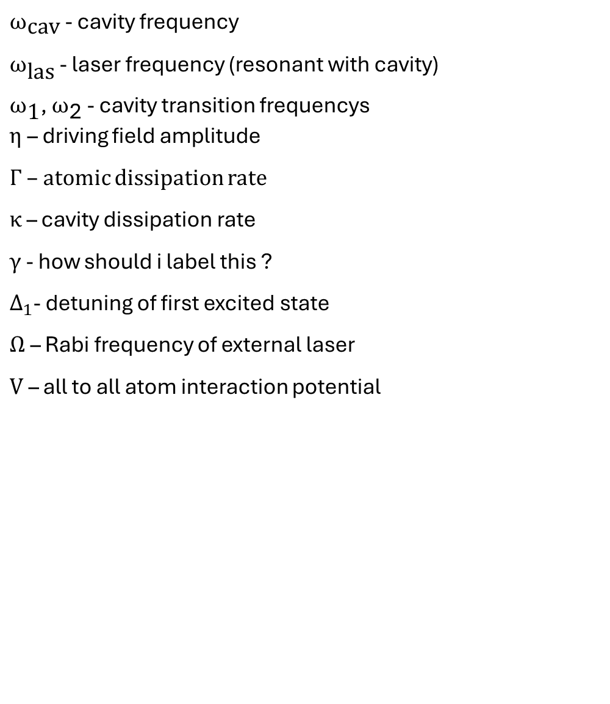
Framework
We look at a system composed of three-level atoms confined within an optical cavity.
$ω_{\text{cav}}$ - cavity frequency
$ω_{\text{las}}$ - laser frequency (resonant with cavity)
$ω_{\text{1}}$, $ω_{\text{2}}$ - cavity transition frequencys
$η$– driving field amplitude
$Γ$ – atomic dissipation rate
$κ$ – cavity dissipation rate
$γ$ - how should i label this ?
$Δ_{1}$- detuning of first excited state
$Ω$ – Rabi frequency of external laser
$\text{V}$ – all to all atom interaction potential

Slide 10
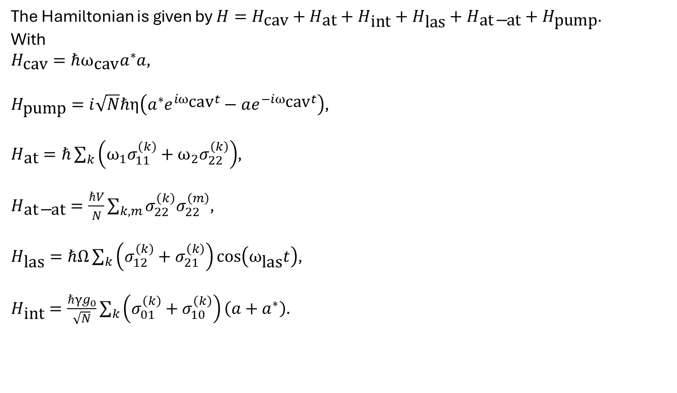
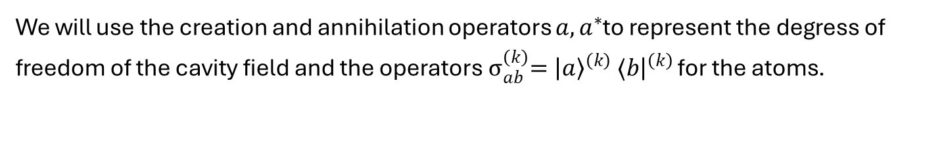
Framework - Formalism
We will use the creation and annihilation operators $a,a^{∗}$to represent the degress of freedom of the cavity field and the operators${ σ}_{ab}^{\left(k\right)}={\left|a\right\rangle }^{\left(k\right)} ⟨b{\left.​\right|}^{\left(k\right)}$ for the atoms.
The Hamiltonian is given by $H=H_{\text{cav}}+H_{\text{at}}+H_{\text{int}}+H_{\text{las}}+H_{\text{at}\text{−}\text{at}}+H_{\text{pump}}.$
With
$H_{\text{cav}}=ℏω_{\text{cav}}a^{∗}a$,
$H_{\text{pump}}=i\sqrt{N}ℏη\left(a^{∗}e^{iω_{\text{cav}}t}−ae^{−iω_{\text{cav}}t}\right)$,
$H_{\text{at}}=ℏ\sum_{k}{\left(ω_{1}σ_{11}^{\left(k\right)}+ω_{2}σ_{22}^{\left(k\right)}\right)}$,
$H_{\text{at}\text{−}\text{at}}=\frac{ℏV}{N}\sum_{k,m}{σ_{22}^{\left(k\right)}σ_{22}^{\left(m\right)}}$,
$H_{\text{las}}=ℏΩ\sum_{k}{\left(σ_{12}^{\left(k\right)}+σ_{21}^{\left(k\right)}\right)\text{cos}\left(ω_{\text{las}}t\right)}$,
$H_{\text{int}}=\frac{ℏγg_{0}}{\sqrt{N}}\sum_{k}{\left(σ_{01}^{\left(k\right)}+σ_{10}^{\left(k\right)}\right)\left(a+a^{∗}\right)}$.
To simplify the treatment, switch to rotating frame.

Slide 11

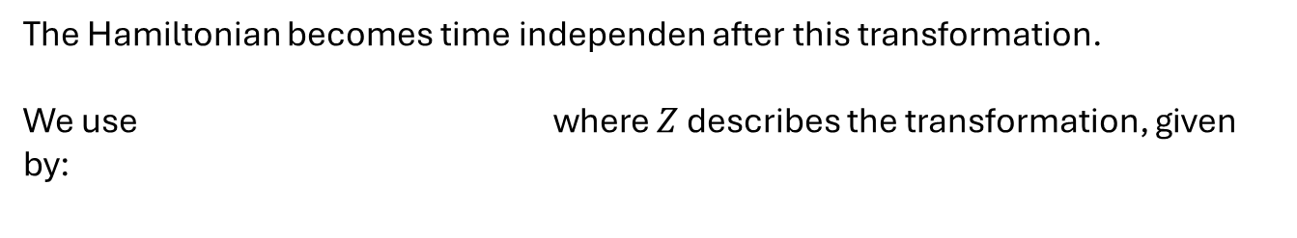

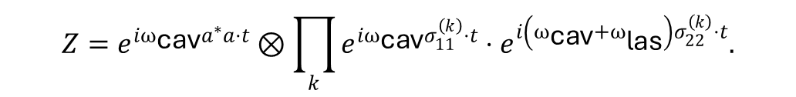
The Hamiltonian becomes time independen after this transformation.
We use where $Z$ describes the transformation, given by:
$$H_{\text{eff}}=ZHZ^{∗}+i\frac{∂Z}{∂t}Z^{∗},$$
$$Z=e^{iω_{\text{cav}}a^{∗}a⋅t}⊗\prod_{k}{e^{iω_{\text{cav}}σ_{11}^{\left(k\right)}⋅t}}⋅e^{i\left(ω_{\text{cav}}+ω_{\text{las}}\right)σ_{22}^{\left(k\right)}⋅t}.$$
While performing the calculation, we used a RWA.
The time independent Hamiltonian in the rotating frame reads
$$H_{\text{eff}}=ℏ\sum_{k}{\left[\left(Δ_{1}σ_{11}^{\left(k\right)}+Δ_{2}{σ }_{22}^{\left(k\right)}\right)+\frac{γg_{0}}{\sqrt{N}}\left(σ_{01}^{\left(k\right)}a^{∗}+σ_{01}^{\left(k\right)}a\right)+\frac{Ω}{2}\left(σ_{12}^{\left(k\right)}+σ_{21}^{\left(k\right)}\right)+i\sqrt{N}η\left(a^{∗}−a\right)\right]}+ℏ\frac{V}{N}\sum_{k,n}{{ σ}_{22}^{\left(k\right)}σ_{22}^{\left(n\right)}}$$
$$Δ_{1}=ω_{1}−ω_{\text{cav}}$$
$$Δ_{2}=ω_{2}−ω_{\text{las}}−ω_{\text{cav}}$$
carefull ! $Δ_{2}$ is not an actual detuning in the classical sense!

Slide 12
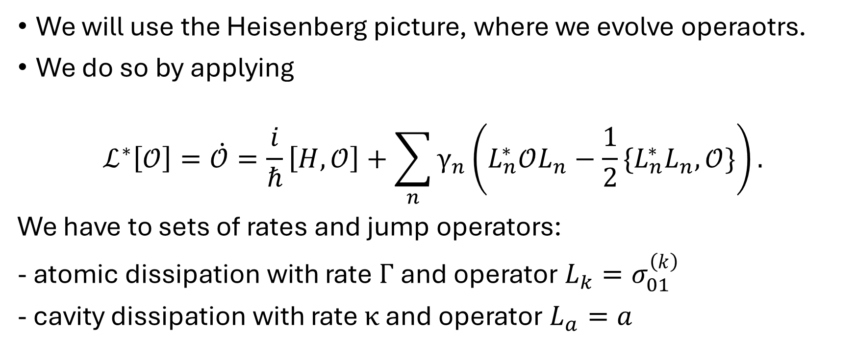
Framework - Equations of motion
We will use the Heisenberg picture, where we evolve operaotrs.
We do so by applying
$$ℒ^{∗}\left[𝒪\right]=\dot{𝒪}=\frac{i}{ℏ}\left[H,𝒪\right]+\sum_{n}{γ_{n}\left(L_{n}^{∗}𝒪L_{n}−\frac{1}{2}\{L_{n}^{∗}L_{n},𝒪\}\right)}.$$
We have to sets of rates and jump operators:
- atomic dissipation with rate$Γ$and operator $L_{k}=σ_{01}^{\left(k\right)}$
- cavity dissipation with rate $κ$ and operator $L_{a}=a$

Slide 13

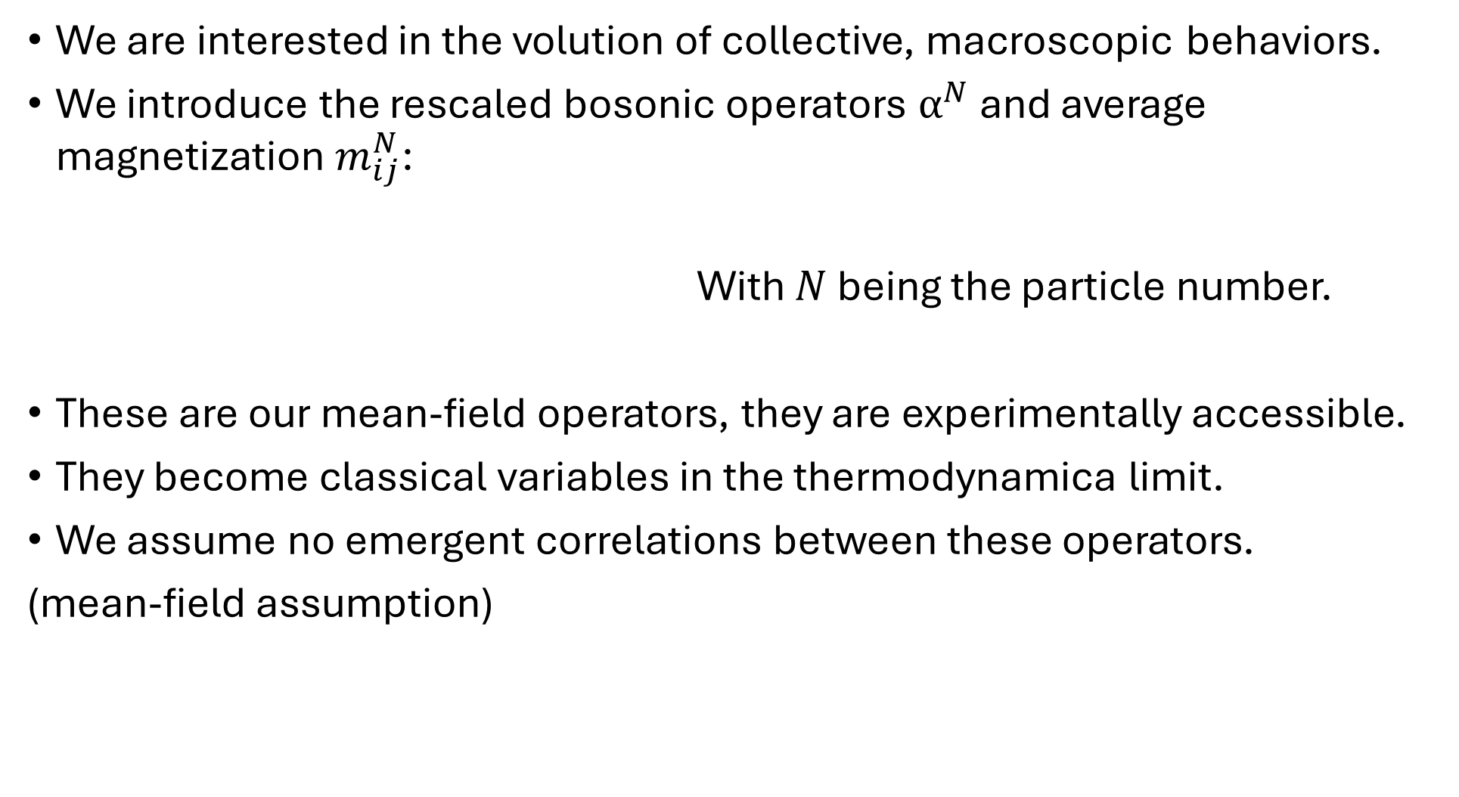

We are interested in the volution of collective, macroscopic behaviors.
We introduce the rescaled bosonic operators $α^{N}$ and average magnetization $m_{ij}^{N}$:
With $N$ being the particle number.
These are our mean-field operators, they are experimentally accessible.
They become classical variables in the thermodynamica limit.
We assume no emergent correlations between these operators.
(mean-field assumption)
$$m_{ij}^{N}=\frac{\sum_{k=1}^{N}{{ σ}_{ij}^{\left(k\right)}}}{N}.$$
$$α^{N}=\frac{a}{\sqrt{N}},$$

Slide 14
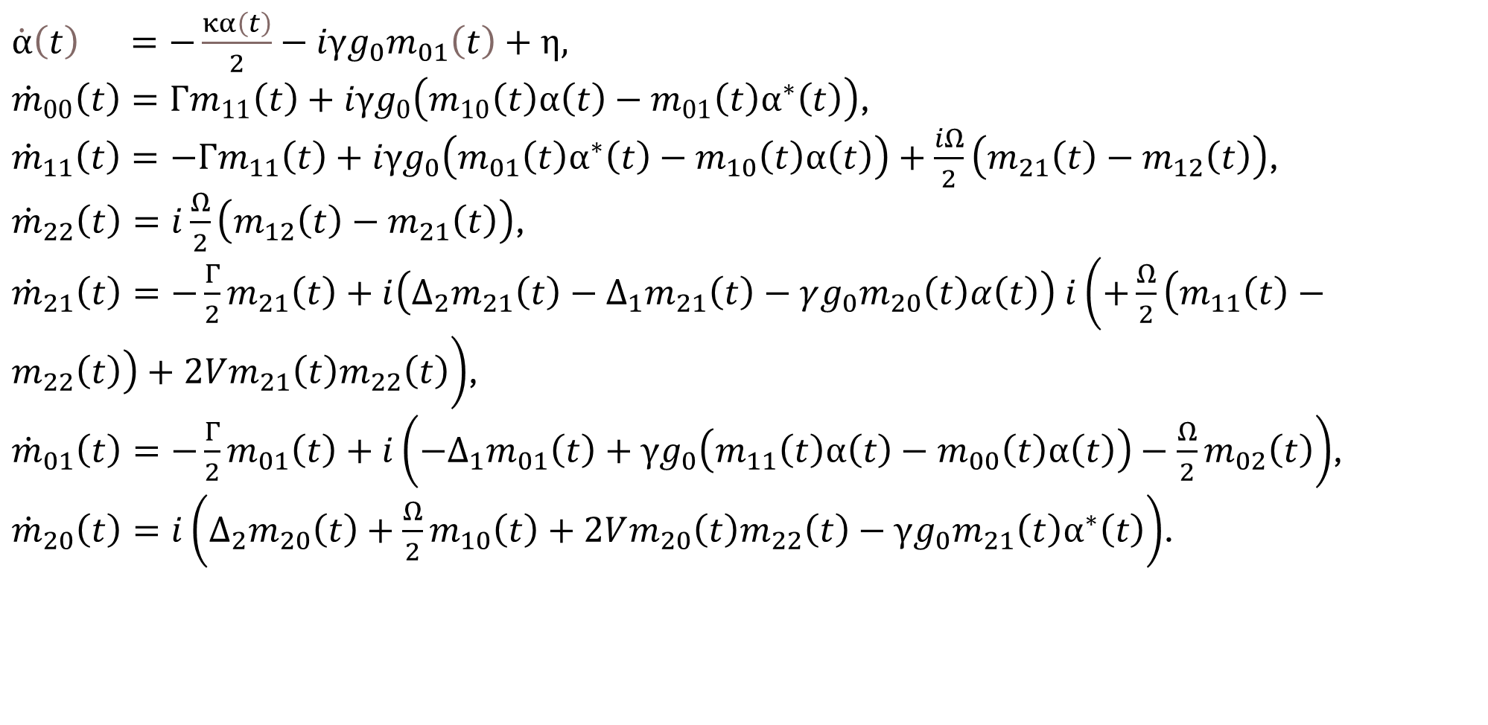
Our equations of motion read
$\dot{α}\left(t\right) =−\frac{κα\left(t\right)}{2}−iγg_{0}m_{01}\left(t\right)+η,$
${\dot{m}}_{00}\left(t\right)=Γm_{11}\left(t\right)+iγg_{0}\left(m_{10}\left(t\right)α\left(t\right)−m_{01}\left(t\right)α^{∗}\left(t\right)\right)$,
${\dot{m}}_{11}\left(t\right)=−Γm_{11}\left(t\right)+iγg_{0}\left(m_{01}\left(t\right)α^{∗}\left(t\right)−m_{10}\left(t\right)α\left(t\right)\right)+\frac{iΩ}{2}\left(m_{21}\left(t\right)−m_{12}\left(t\right)\right)$,
${\dot{m}}_{22}\left(t\right)=i\frac{Ω}{2}\left(m_{12}\left(t\right)−m_{21}\left(t\right)\right)$,
${\dot{m}}_{21}\left(t\right)=−\frac{Γ}{2}m_{21}\left(t\right)+i\left(Δ_{2}m_{21}\left(t\right)−Δ_{1}m_{21}\left(t\right)−γg_{0}m_{20}\left(t\right)α\left(t\right)\right) i\left(+\frac{Ω}{2}\left(m_{11}\left(t\right)−m_{22}\left(t\right)\right)+2Vm_{21}\left(t\right)m_{22}\left(t\right)\right)$,
${\dot{m}}_{01}\left(t\right)=−\frac{Γ}{2}m_{01}\left(t\right)+i\left(−Δ_{1}m_{01}\left(t\right)+γg_{0}\left(m_{11}\left(t\right)α\left(t\right)−m_{00}\left(t\right)α\left(t\right)\right)−\frac{Ω}{2}m_{02}\left(t\right)\right)$,
${\dot{m}}_{20}\left(t\right)=i\left(Δ_{2}m_{20}\left(t\right)+\frac{Ω}{2}m_{10}\left(t\right)+2Vm_{20}\left(t\right)m_{22}\left(t\right)−γg_{0}m_{21}\left(t\right)α^{∗}\left(t\right)\right)$.
Note that, for the model at hand, the mean-field equations are exact in the thermodynamic limit.

Slide 15
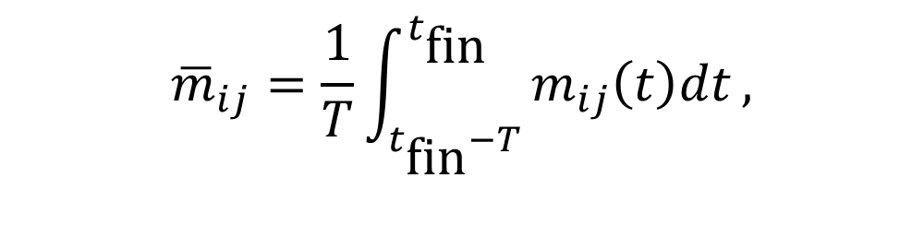

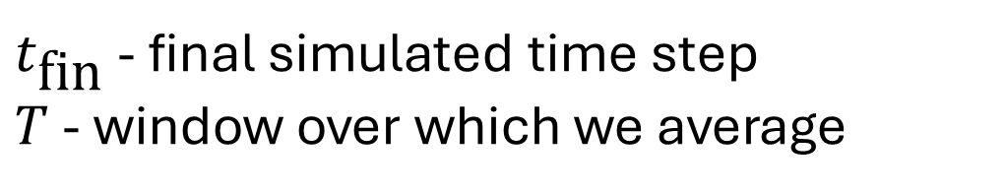
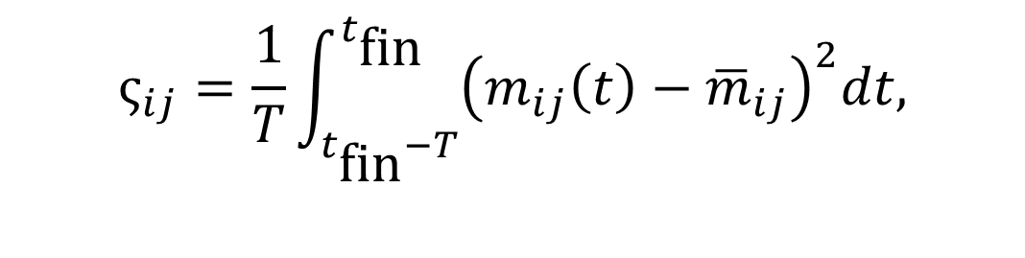
Phase diagram
We will numerically solve the mean-field equations.
We use the time averaged order parameter ${\overline{m}}_{ij}$ and time variance $ς_{ij}$, defined by
to classify phases.
$${\overline{m}}_{ij}=\frac{1}{T}\int_{t_{\text{fin}}−T}^{t_{\text{fin}}}{m_{ij}\left(t\right)dt},$$
$$ς_{ij}=\frac{1}{T}\int_{t_{\text{fin}}−T}^{t_{\text{fin}}}{{\left(m_{ij}\left(t\right)−{\overline{m}}_{ij}\right)}^{2}dt,}$$
$t_{\text{fin}}$ - final simulated time step
$T$ - window over which we average

Slide 16
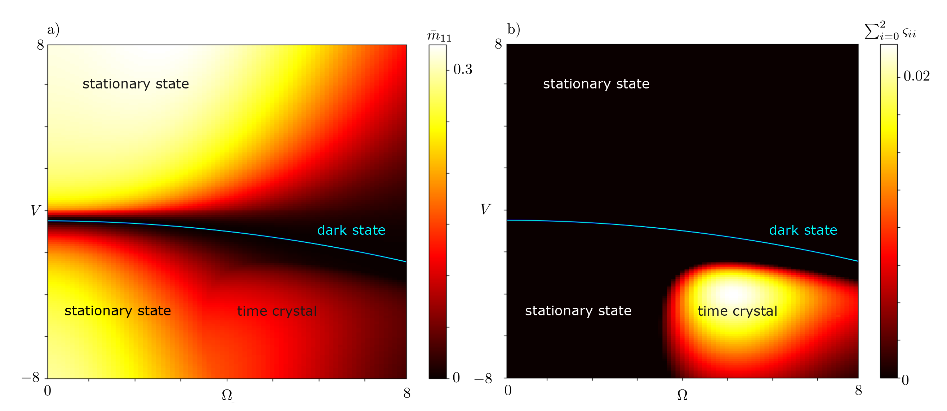
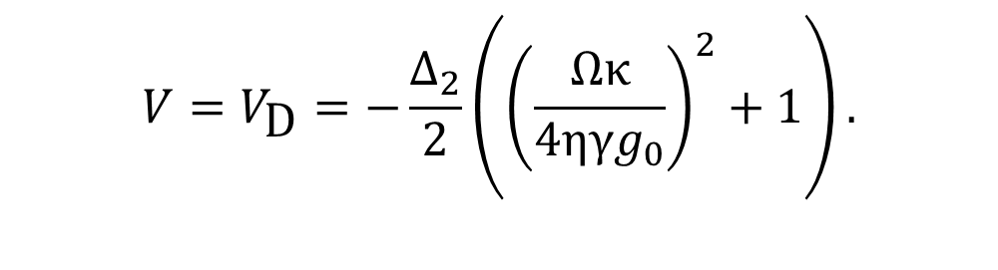

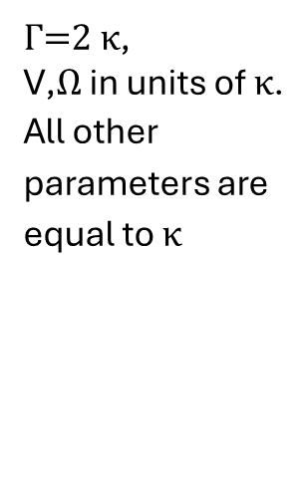
We have determind the condition for a stationary state being dark to be
We use initial state ${\text{m}}_{00}\left(0\right)=1$, everything else zero.
$$V=V_{\text{D}}=−\frac{Δ_{2}}{2}\left({\left(\frac{Ωκ}{4ηγg_{0}}\right)}^{2}+1\right).$$
$Γ$=2 $κ$,
$\text{V}$,$Ω$ in units of $κ$.
All other parameters are equal to $κ$

Slide 17
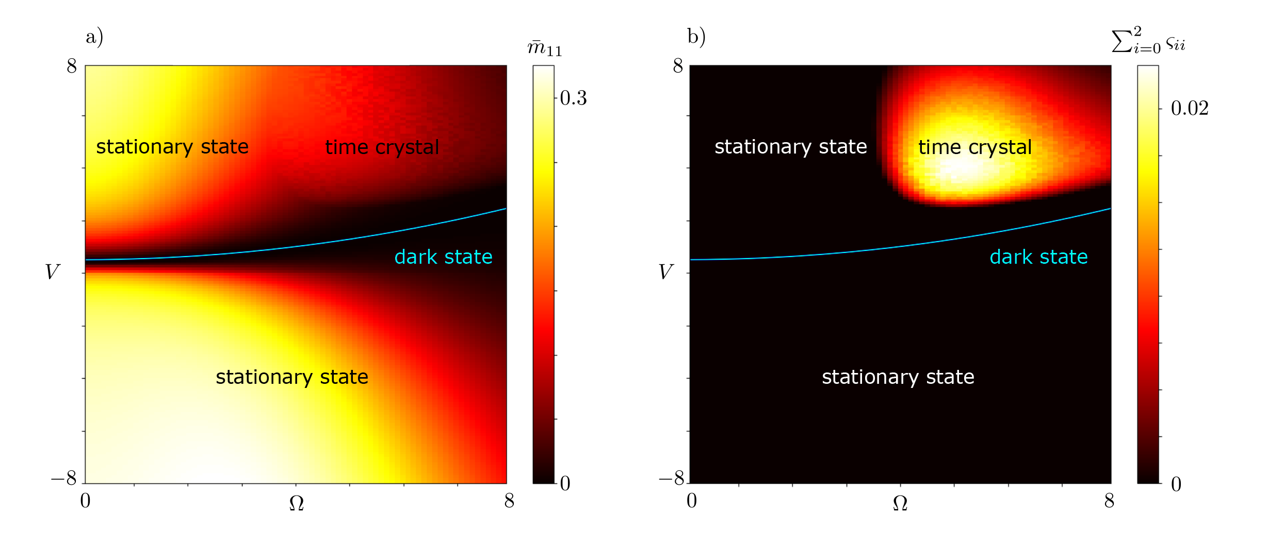
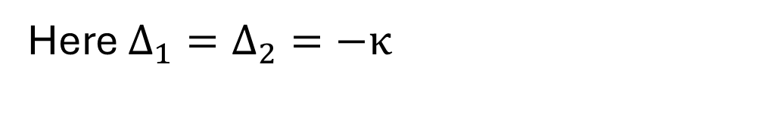
Here $Δ_{1}=Δ_{2}=−κ$

Slide 18
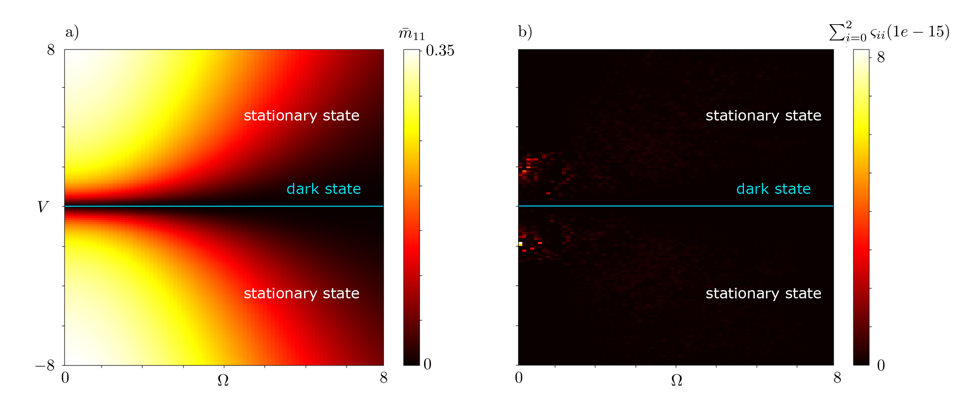
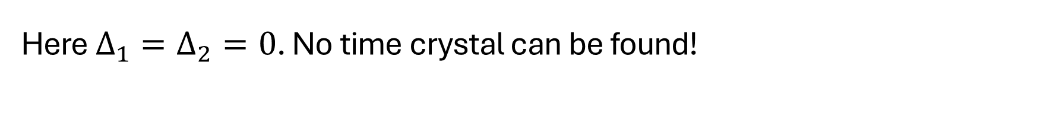
Here $Δ_{1}=Δ_{2}=0$. No time crystal can be found!

Slide 19
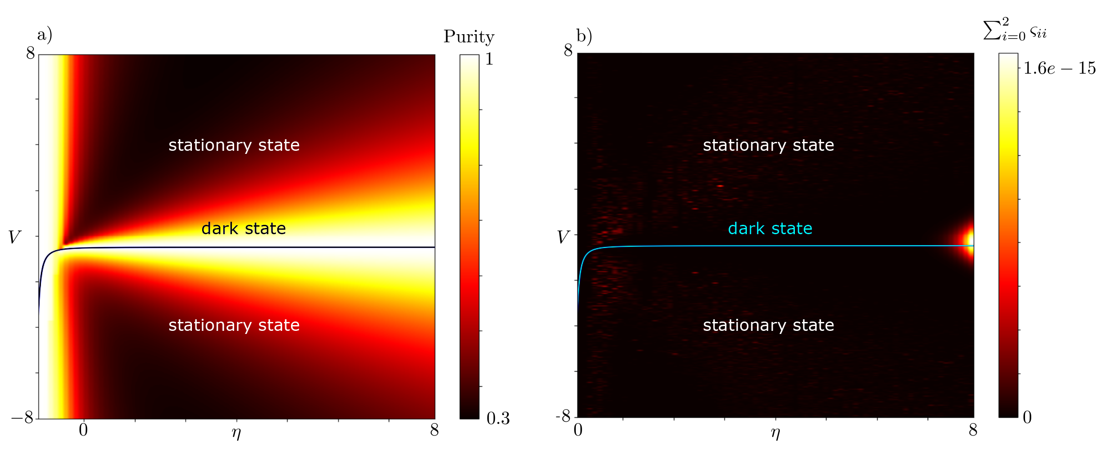

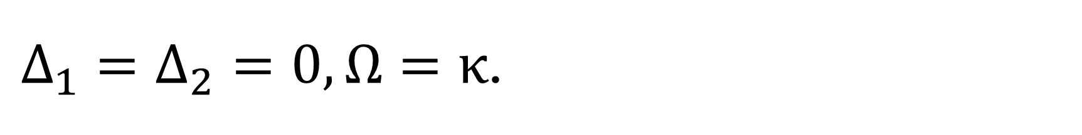
$Δ_{1}=Δ_{2}=0,Ω=κ$.

Slide 20
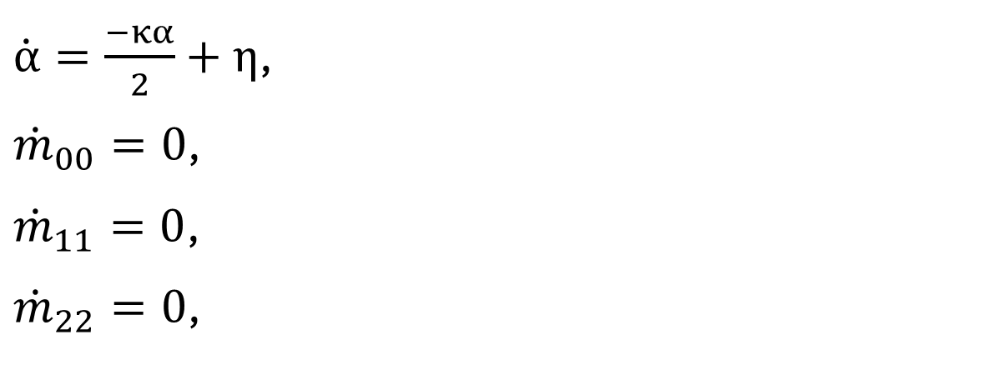

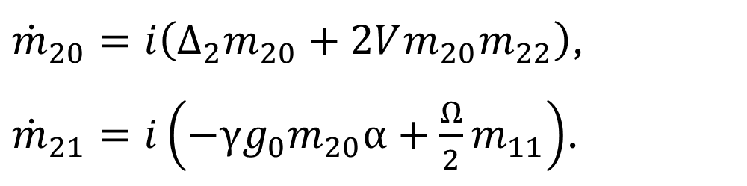
Is it possible to link dark state to EIT ?
Yes.
Impose no interaction with first excited state
$m_{11}\left(0\right)=m_{01}\left(0\right)=m_{21}\left(0\right)=m_{12}\left(0\right)=m_{10}\left(0\right)=0$.
Bosonic and atomic systems are decoupled!
This state is emergent -> only exact in thermodynamic limit.
$\dot{α}=\frac{−κα}{2}+η$,
${\dot{m}}_{00}=0$,
${\dot{m}}_{11}=0$,
${\dot{m}}_{22}=0$,
${\dot{m}}_{20}=i\left(Δ_{2}m_{20}+2Vm_{20}m_{22}\right)$,
${\dot{m}}_{21}=i\left(−γg_{0}m_{20}α+\frac{Ω}{2}m_{11}\right)$.

Slide 21
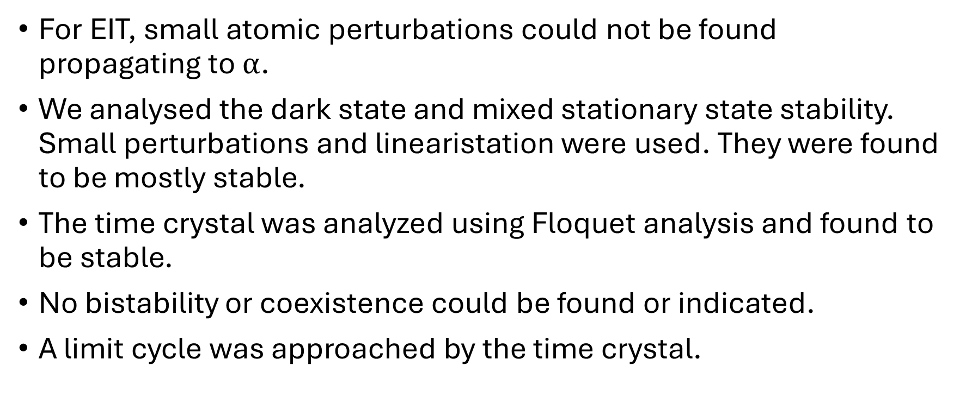
Stability
For EIT, small atomic perturbations could not be found propagating to $α$.
We analysed the dark state and mixed stationary state stability. Small perturbations and linearistation were used. They were found to be mostly stable.
The time crystal was analyzed using Floquet analysis and found to be stable.
No bistability or coexistence could be found or indicated.
A limit cycle was approached by the time crystal.

Slide 22
Outlook
Investigate quantum fluctuations.
Compare with real experimental data of similar systems.
Explore more parameter regimes.

Slide 23
Conclusion
We set up the equations of motion for our system
We found a analytical classification for the dark state
We investigated the stability of our phases
Thanks for your attention!

Slide 24
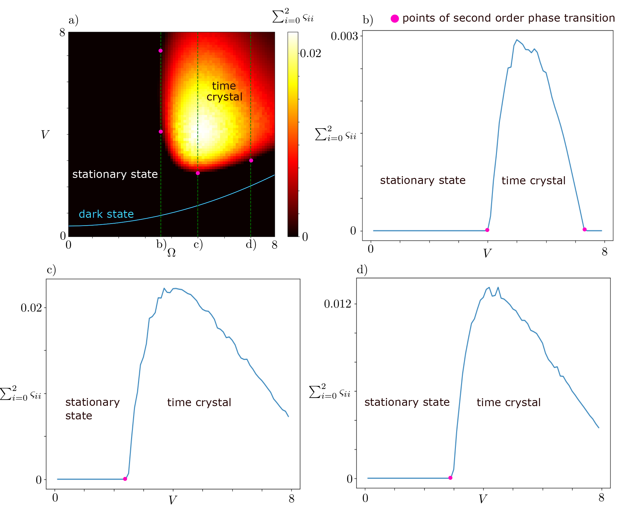
Time crystal extra material

Slide 25
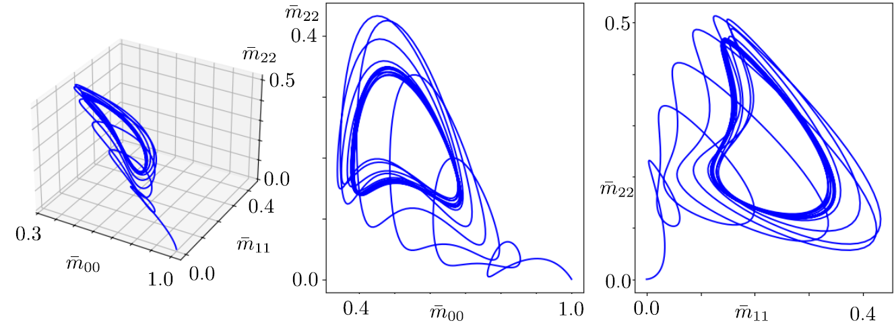
Limit cycle in magnetization space

Slide 26
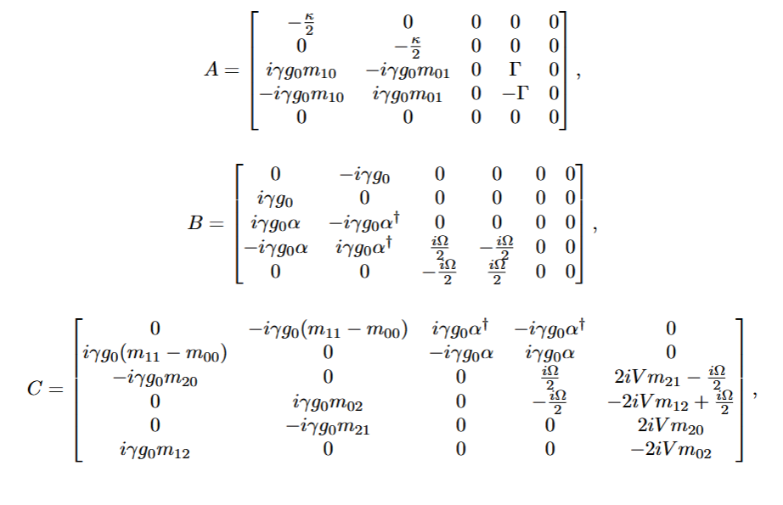
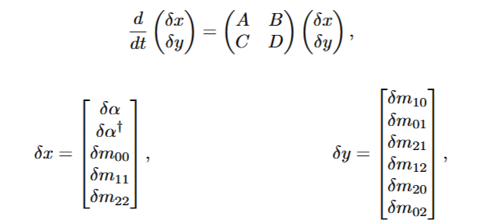
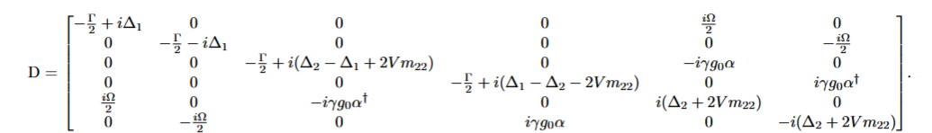
Stationary- / Dark- state stability
We define a fixed point and slightly perturb the system.
We approximate by performing a Taylor expansion, only retaining linear terms.
The full system equations read

Slide 27



for certain small $Γ$values, positive eigenvalues appear, indicating instability.
$Γ$=2 $κ$, $Δ_{1}=Δ_{2}=−κ$
$\text{V}$,$Ω$ in units of $κ$.
All other parameters are equal to $κ$

